Slide 1
ChatBot Sprint 3 Demo
Website Dataset
Aaron Antreassian, Christopher Mata, and Eli Kulpinski

Slide 2
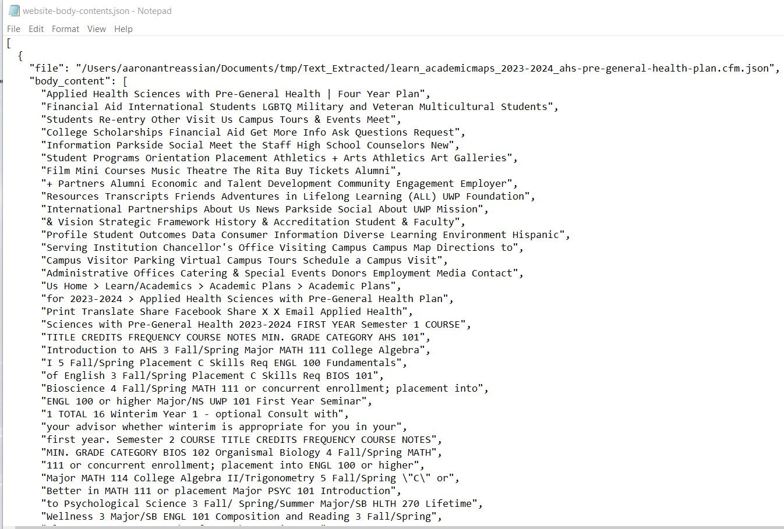
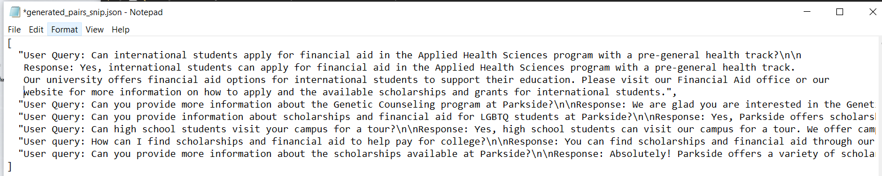
Sprint Contributions
Aaron:
Cloned Parkside Website for Dataset and Frontend.
Performed content testing on the website clone.
Extracted and cleaned HTML body contents to JSON.
Prepared data for Eli’s conversion to prompt-response pairs.
Chris:
Conducted security testing pre-fine-tuning.
Created security-oriented prompt-response pairs.
Researched vectorized databases and managed dataset deployment.
Provided support for website cloning issues.
Eli:
Analyzed trending models, confirming Mistral OpenOrca's suitability.
Evaluated dataset cleanliness from Aaron’s extraction.
Selected QLoRa for fine-tuning method.
Converted JSON data to prompt-response format.
Generated synthetic prompts for each response.
Made the slideshow for demo presentation.

Slide 3
Sprint 3 Objectives
Meet with Matt McPherson about Deployment Server (chat.cs.uwp.edu)
Clone Parkside and Related Websites
Convert Relevant Webpage Contents (HTML to TXT)
Clean Website Contents (TXT File)
Format the Website Contents Dataset as Prompt-Response
Compare and Decide Fine-Tuning Method (PPO, DPO, LORA, QLORA, LOFTQ, AWQ, GPTQ, NEFT, Etc)
Model Evaluation Before Fine-Tuning (For Comparison Post Fine-Tuning)
Deploy Dataset into Vectorized Database
Security Testing for Model Before Fine-Tuning

Slide 4
Creating Our Dataset
Initiated with cloning the Parkside website to capture a dataset reflective of user interactions.
Conducted comprehensive content testing to ensure the cloned data's fidelity to the original source.
Extracted HTML body contents, transforming them into a structured JSON format.
Undertook meticulous cleaning of JSON content to remove noise and irrelevant data.
Coordinated with the development team to align the dataset structure with chatbot requirements.
Prepared and organized the dataset to facilitate the transformation into prompt-response pairs.
Utilized the refined prompt-response pairs as a reference for GPT-3.5 to synthetically generate a custom dataset tailored to our chatbot's needs.

Slide 5
Security Considerations
Explored the creation of a specialized security model to handle sensitive content and user interactions.
Identified the potential for prompt poisoning and developed mitigation strategies through prompt-response training.
Implemented temperature setting adjustments to reduce the generation of controversial content.
Proposed an initial seeding strategy to remind the LLM of its identity as a "UW Parkside expert" for better security.
Chris created security-oriented prompt-response pairs to instruct the model on handling illicit content requests.
Decided on a dual-model approach, depending on server performance, to enhance response security.

Slide 6
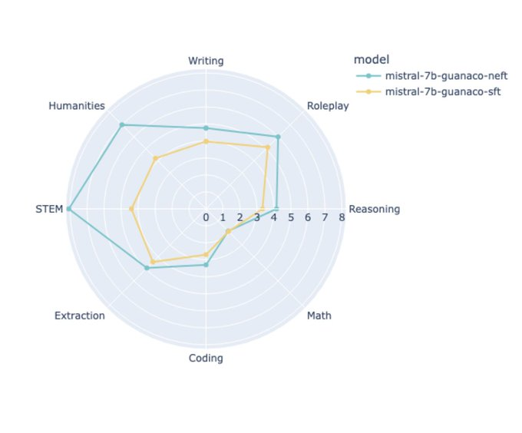
Project Improvements From Website Dataset
By making a dataset on information about Parkside, our project enjoys the following benefits:
Enhanced chatbot relevance with Parkside-specific data
Improved accuracy and context awareness in responses
Fine-tuned natural language understanding with website data
Expanded query handling with broader dataset scope
Enabled deeper analysis for ongoing chatbot response improvement

Slide 7
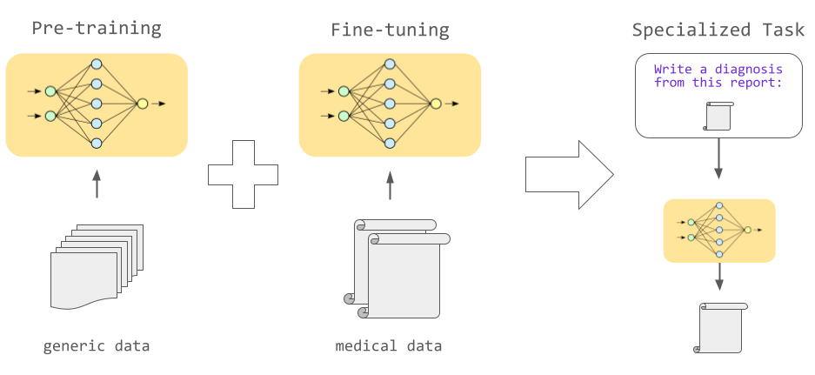
Sprint 4: Fine-Tuning Our Model
Fine-tune local model with website dataset for domain-specific enhancement
Discuss and evaluate additional tools (web search, vector databases) for integration
Test server configurations for performance-quantization balance
Set up and deploy server with Matt McPhersm for optimal performance
Evaluate model performance metrics
Assess fine-tuned model security

